Slide 1
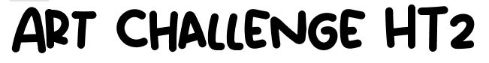
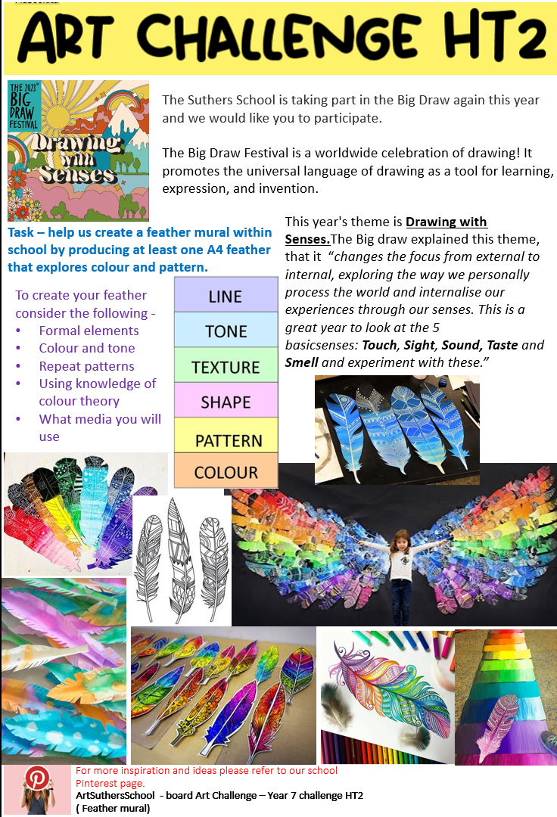
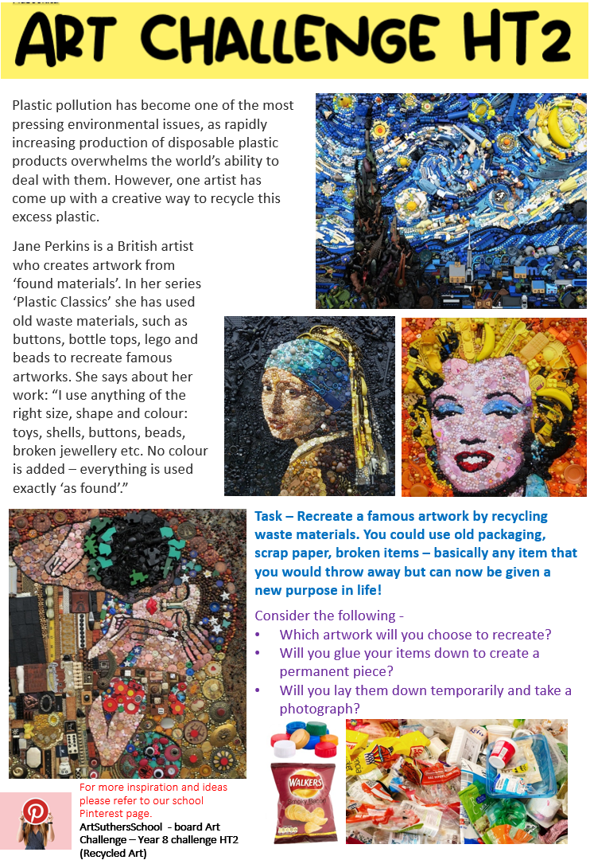

Deadline for HT2 challenge – 14th December
Bring this to Miss Leach to get your sticker
Remember you must complete 3 out of the 6 challenges throughout the year.
Year 7
Year 8
Year 9

