Slide 1
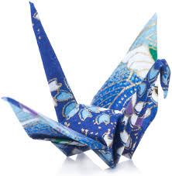
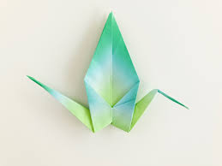
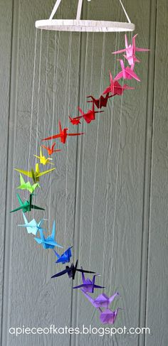
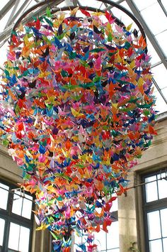
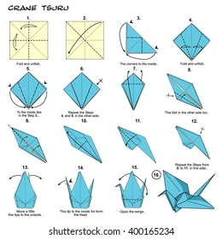
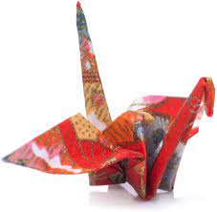
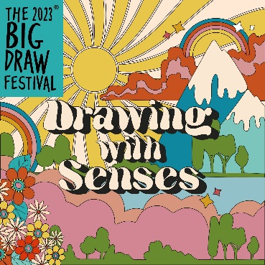
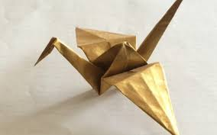
For help and tutorials please refer to our school Pinterest page. ArtSuthersSchool - board Art Challenge – Year 7 challenge HT6 (Origami)
Origami is the art of paper folding. Its name derives from Japanese words ori (“folding”) and kami (“paper”). Traditional origami consists of folding a single sheet of square paper into a sculpture without cutting, gluing, taping, or even marking it.
According to Japanese tradition, folding 1,000 paper cranes gives a person a chance to make one special wish come true. The crane is believed to live for 1,000 years and that is the meaning behind 1,000 an individual needs to fold.
In Japanese folklore, the crane (or Tsuru in Japanese) is a strong majestic bird that mates for life and is said to live for a thousand years. It symbolizes honor, good fortune, loyalty, and longevity.
Task – Explore origami and create a crane to add to our collect to try and make 1,000 to display in school.
This challenge is also part of the Big Draw.

Slide 2
For help and tutorials please refer to our school Pinterest page. ArtSuthersSchool - board Art Challenge – Year 8 challenge HT6 (Origami)
Origami is the art of paper folding. Its name derives from Japanese words ori (“folding”) and kami (“paper”). Traditional origami consists of folding a single sheet of square paper into a sculpture without cutting, gluing, taping, or even marking it.
According to Japanese tradition, folding 1,000 paper cranes gives a person a chance to make one special wish come true. The crane is believed to live for 1,000 years and that is the meaning behind 1,000 an individual needs to fold.
In Japanese folklore, the crane (or Tsuru in Japanese) is a strong majestic bird that mates for life and is said to live for a thousand years. It symbolizes honor, good fortune, loyalty, and longevity.
Task – Explore origami and create a crane to add to our collect to try and make 1,000 to display in school.
This challenge is also part of the Big Draw.

Slide 3
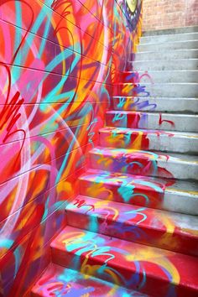
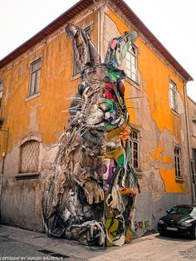
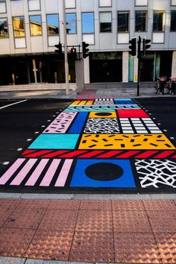
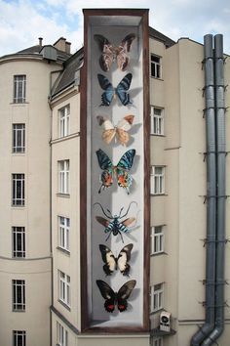
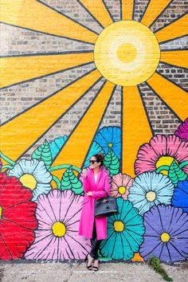
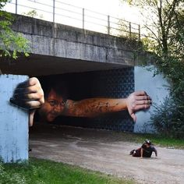
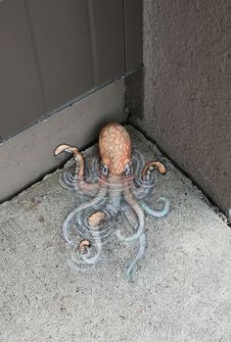
For more inspiration and ideas please refer to our school Pinterest page. ArtSuthersSchool - board Art Challenge – Year 9 challenge HT6 ( Street Art)
Information from Tate website –
Street art is related to graffiti art in that it is created in public locations and is usually unsanctioned, but it covers a wider range of media and is more connected with graphic design.
Where modern-day graffiti revolves around ‘tagging’ and text-based subject matter, street art is far more open. There are no rules in street art, so anything goes. However common materials and techniques include fly-posting (also known as wheat-pasting), stenciling, stickers, freehand drawing and projecting videos.
Street artists will often work in studios, hold gallery exhibitions or work in other creative areas: they are not anti-art, they simply enjoy the freedom of working in public without having to worry about what other people think.
Many well-known artists started their careers working in a way that we would now consider to be street art, for example, Gordon Matta-Clark, Jenny Holzer and Barbara Kruger.
Task – design a piece of street art for an urban space this could be anything from a wall to stairs to the footpath. Draw out the original space or work on top of an image, using this as a foundation to draw out your design. Be as imaginative as you can… do you want to create an optical illusion, are you conveying a message or are you creating a visual art piece?
To create your street art design consider the following -
Formal elements
Who are you inspired by and why?
Composition
Colour selection
Imagery choose
Are you portraying a message?

