Slide 1

Start your Bronze DofE

Slide 2
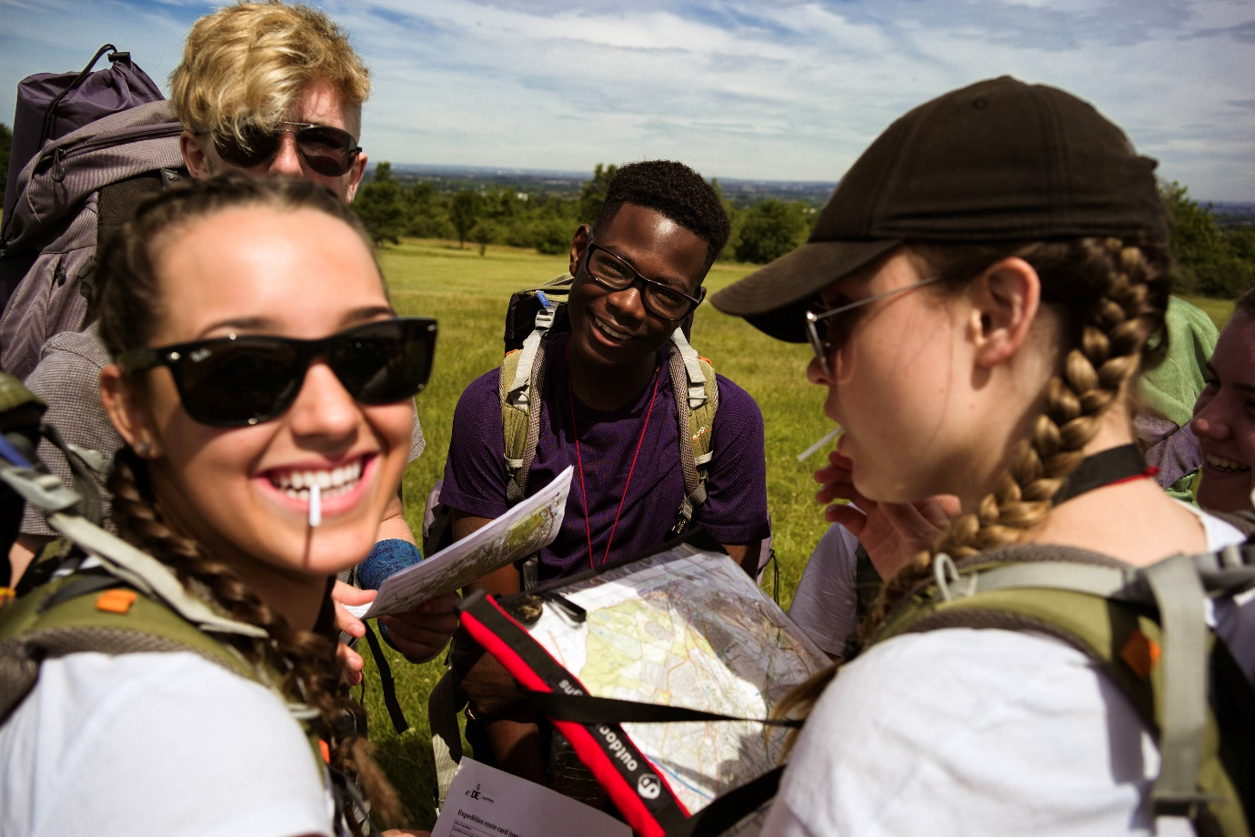
What is the DofE?
BRONZE
The DofE’s a life-changing adventure you don’t want to miss.
It’s about going the extra mile ­– learning new skills for work and life, getting fitter, making a difference and broadening your horizons.
Millions of young people in the UK have already done their DofE.
Now it’s your turn.

Slide 3
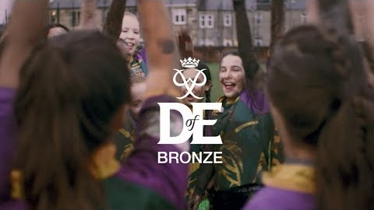
What is the DofE?
BRONZE

Slide 4
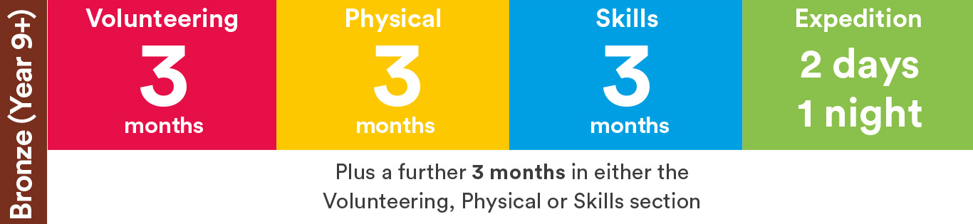
How do I choose my activities?
BRONZE
There’s loads to choose from ­­— most activities can count towards your DofE.
Maybe you want to try something new? Or get better at something you already do? Your DofE can be whatever you want it to be.
Activities for each section take a minimum of one hour a week over a set period of time, so they can fit in around your studies and life outside school.

Slide 5
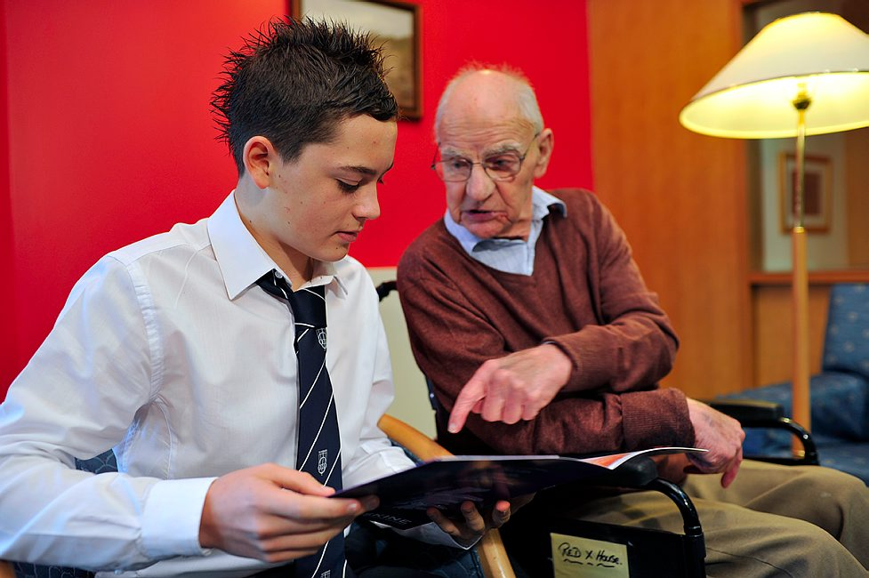
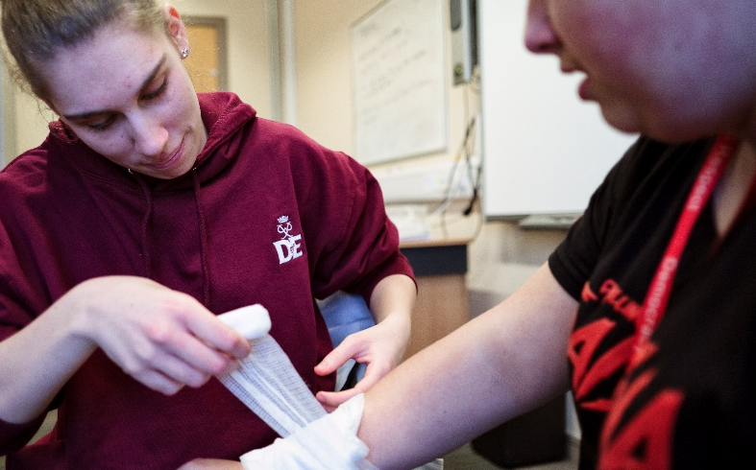
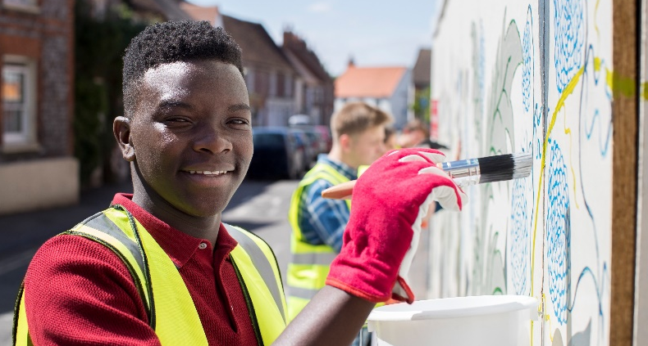
Volunteering
BRONZE
Volunteering’s all about taking action and making a difference to other people’s lives.
Maybe you’re interested in animals or tackling climate change? Or you want to raise money for a cause that means a lot to you?
From coaching a local football team or collecting for a foodbank to starting a campaign, you’ll give up your time to help others and change things for the better.
It’s extremely rewarding, grows your confidence and independence — and can give you the chance to experience the world of work too.
  Over
¾
feel happier
because volunteering
gave them more
confidence
88%
believe volunteering
helps them feel more
satisfied in life
96%
  say volunteering
  gave them a sense
  of achievement

Slide 6
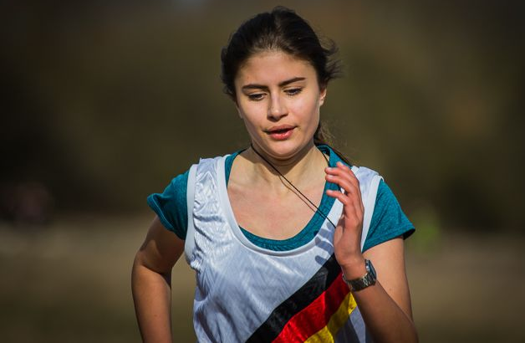
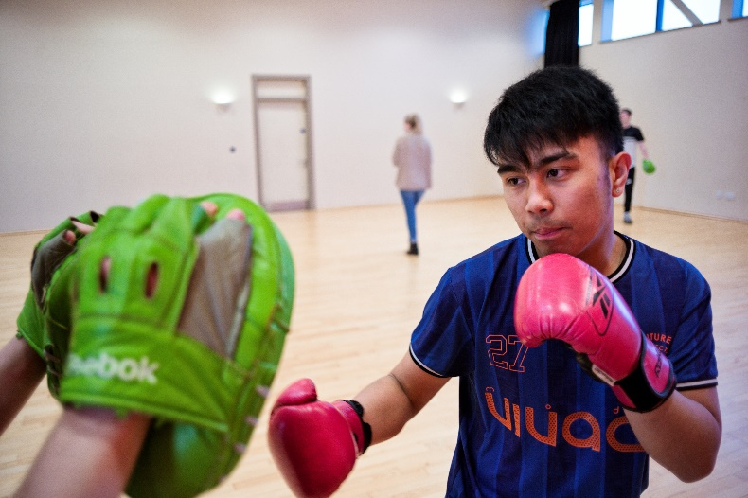
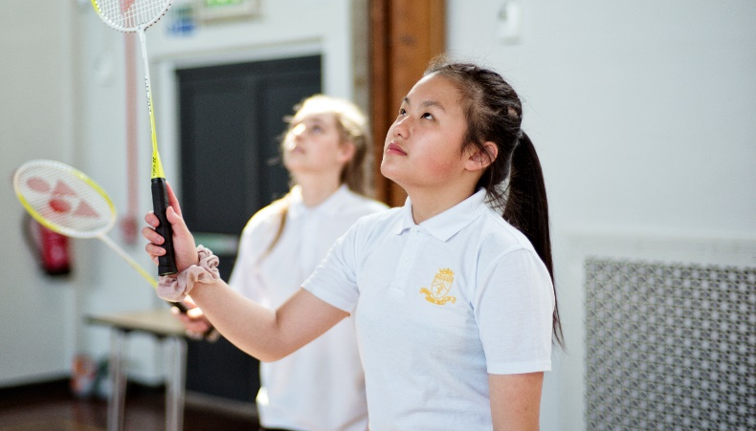
Physical
BRONZE
The Physical section is a chance for you to focus on your health and fitness and have fun along the way.
Try something completely different or concentrate on something you already do, as long as it requires a continuous level of energy and physical activity.
From yoga to going to the gym, skateboarding to wheelchair tennis­ — almost any dance, sport or fitness activity can count.
And doing more physical activity can give your mental health a great boost too.
You can decide to join a team or do it on your own — it’s up to you.

Slide 7
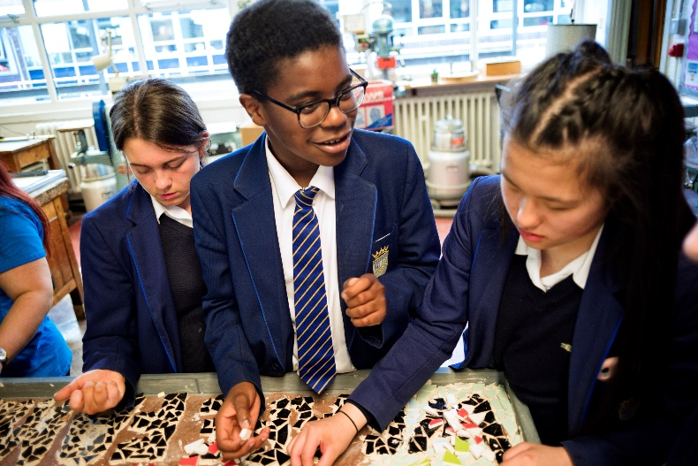
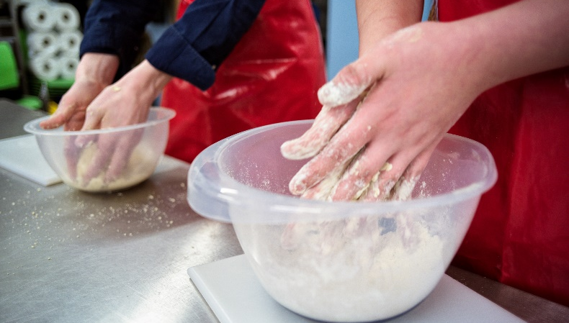

Skills
BRONZE
From coding to cookery, the Skills section lets you learn a new talent, develop existing skills and discover new things you love.
By developing practical and social skills and gaining interests and talents, you’ll enjoy yourself and get a real sense of achievement.
If you’re interested in a specific field, this could be the perfect chance for you to do something related to it. So, if you’re interested in photography, you could do it as your skill.
You’ll grow your confidence and show you’re committed, motivated and can rise to a challenge.

Slide 8
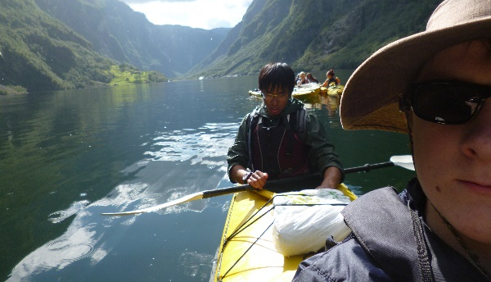
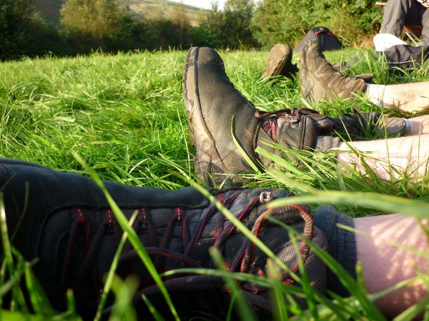
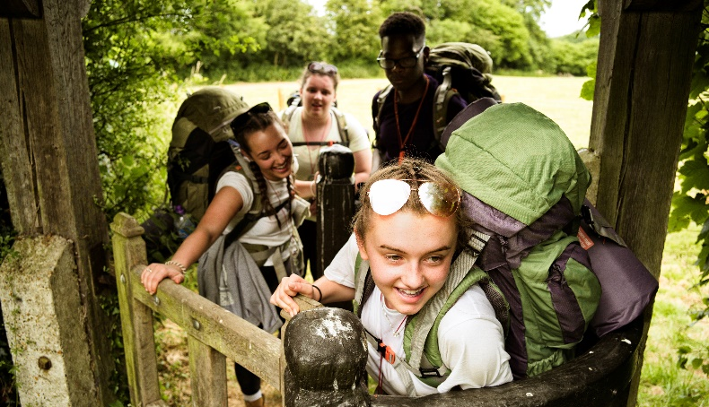
Expedition
BRONZE
Getting into the great outdoors and spending a night away with your friends – your expedition will give you lifelong memories.
As part of a small team, you’ll plan your aim, choose your location and do some training to make sure you’re prepared and know what you’re doing — then spend two days and one night away.
You can choose how you want to travel – it doesn’t have to be on foot. You could do it by bike, canoe, kayak, wheelchair, sailing boat or even on a horse.
Your expedition will improve your resilience, communication, teamwork and leadership skills.
You’ll come home with a rucksack full of washing — and an experience you won’t forget.

Slide 9
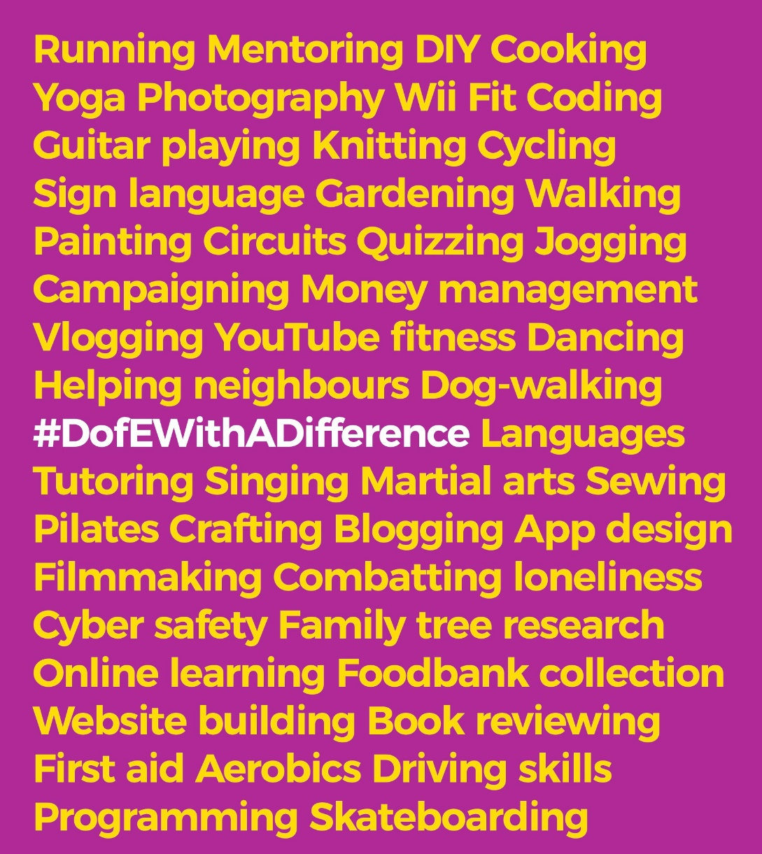
Your DofE and COVID-19
BRONZE
The COVID-19 outbreak won’t stop you doing your DofE – far from it.
In fact, the DofE can help you navigate your ‘new normal’, expand your world and give you skills and experiences that can open doors in the future.
You get to choose and change your own activities, so you can pick ones that are easy to do safely under social distancing guidelines or from home.
There are flexible ways to run expeditions so – when it’s safe to do so and Government guidelines allow – you can do yours, with all the benefits and memories you’d get at any other time.
Visit DofE.org/DofEWithADifference for loads of activity ideas and information.

Slide 10
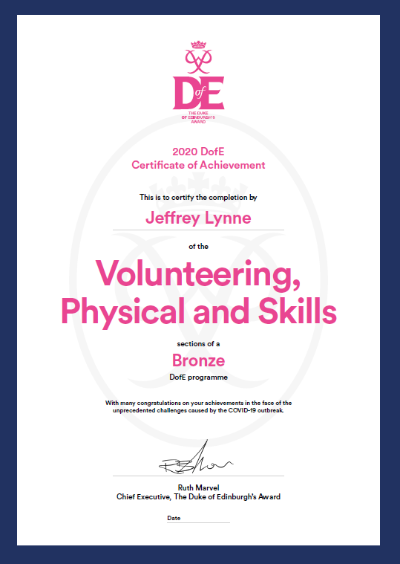
The DofE Certificate of Achievement
BRONZE
During and in the aftermath of the COVID-19 outbreak, participants who complete their Skills, Volunteering and Physical sections will receive a special DofE Certificate of Achievement.
This is a formal recognition, by the DofE, of the effort, skill and commitment you've shown at this extraordinary time.
The Certificate can act as a talking point on your CV or in your personal statement and help you stand out.
And you can still do your expedition and achieve your Bronze DofE Award.

Slide 11

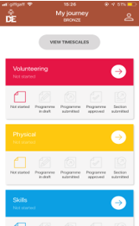
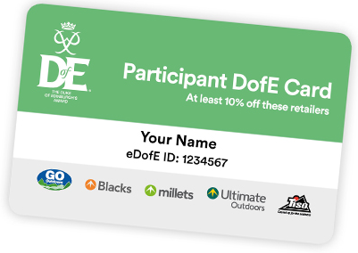
Your Welcome Pack and eDofE
BRONZE
Once you've signed up to do your DofE, you'll get your own eDofE account, so you can start planning your activities online and using the free DofE app.
When you've added your home address, you'll be sent your Welcome Pack – with lots of information and advice, as well as your personalised DofE Card.
Your DofE Card will give you and your family exclusive discounts in the DofE's five fantastic recommended retailers.

Slide 12
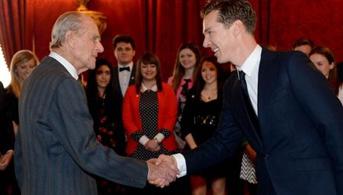
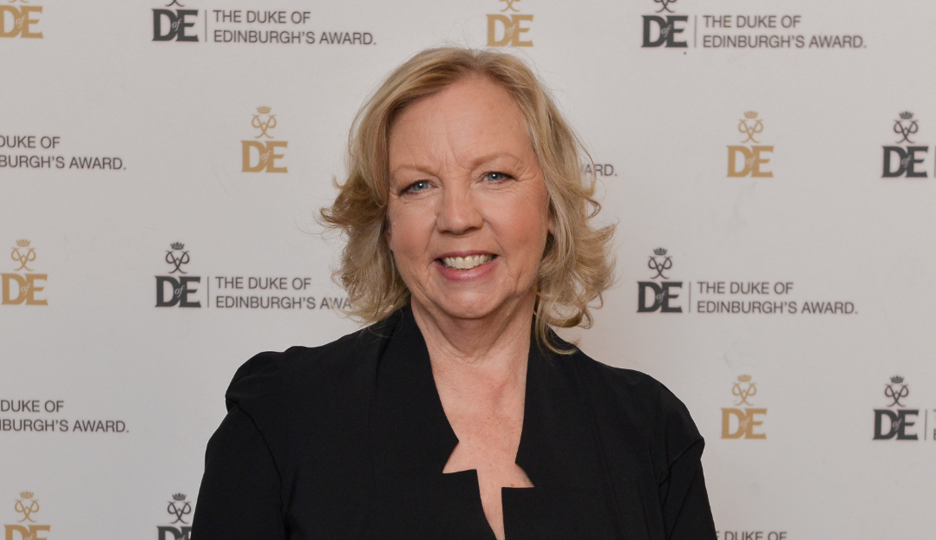
Why do your DofE?
BRONZE
So why should you do your DofE?
It’s hard to list all the benefits of achieving your Bronze Award, so here’s a quick snapshot. You’ll…
Have lots of fun
Get healthier and happier
Meet incredible people and make lasting friendships
Have amazing new experiences
Find talents and passions you didn’t know you had
Gain skills that employers value, which you can use on your CV
Become more confident and independent
Stand out from the crowd in college, university and job applications
Make memories that will last a lifetime.
“As an actor I know how much Award holders’ experiences and the skills they’ve developed matter. Without determination and passion I wouldn’t be where I am today.” Benedict Cumberbatch, actor.
“Life doesn’t naturally happen, you’ve got to get involved. What better way to do that than do your DofE. As an employer I want to work with people who have a range of skills and can see things through.” Deborah Meaden, entrepreneur.

Slide 13
Karos Adventure- Expedition Support
Karos Adventure are one of the leading providers of DofE Expeditions in the Midlands area and beyond.
They provide a quality, well-organised and friendly service to schools and organisations that work with young people from all walks of life.
All aspects of the DofE Bronze Common Training Framework:
Navigation Training Walk.
Countryside Code.
Observation & Recording.
Expedition First Aid & Emergency Management.
Identify & Manage Risks.
Impact of weather.
Team Building.
Kit & Rucksack Packing.
Tent Pitching & Campsite Management.
Cooking & fuel safety.
Food & Menu Planning.
Route Planning Workshop.
Includes at least 1 overnight camp.
Either 1-day Expedition Simulation or 2-day Practice Expedition. Put into practice what you have learnt by undertaking a remotely supervised journey.
Training delivered by our team of qualified & friendly Expedition Leaders.
Review & debrief at end of expedition to highlight successes and adjustments.
All Packages include:
Participants & Parents Information Presentation
Online Factsheets including kit lists, menu ideas and other key information.
Camp site fees for all participants & 2 school staff performing pastoral duties included.
Inclusive use of our Group Equipment - tents, stoves, maps, map cases and group first-aid kits.
Includes all fuel (gas cylinders compatible with our Trangia stoves).
Dedicated admin and organisation that is "second-to-none".
Participant Joining Instructions prior to each event.
Generic & Area-Specific Risk Assessments.
Public Liability Insurance (£10million), AALA and AAP Licences.
Expedition On-Call Support – dedicated “home contact” support during expeditions.

Slide 14
Start your DofE now
BRONZE
Are you ready to start an adventure you’ll never forget?
£23 DofE Registration Fee
£170 Karos Adventure- Expedition Team
Total £193*
Payable over 5 instalments of £38.60
Please complete the attached register of interest form and we will be in touch.
*PP support available, if eligible, please register interest
The DofE is a charity.
Visit DofE.org for more information.

