Slide 1
Year 9 Options Evening
World Class Learning Opportunities for All

Slide 2
Option Choices / Career Provision
The journey so far:
Taster Lessons
Subject Presentations
Initial Options Survey
Visit to Newark College
Engineering Workshop
Careers Interviews for selected students
Unifrog Lessons
Labour Market Information
Next Steps (Year 10 and 11)
One week work experience in Year 10
Mock Interviews
Careers Interviews
Future First Expo
University Fayre
Growing our links to business & industry
Available to speak to tonight:
Sharon Franklin – Ideas for Careers
Judy & Rosie – Lincoln / Newark College

Slide 3
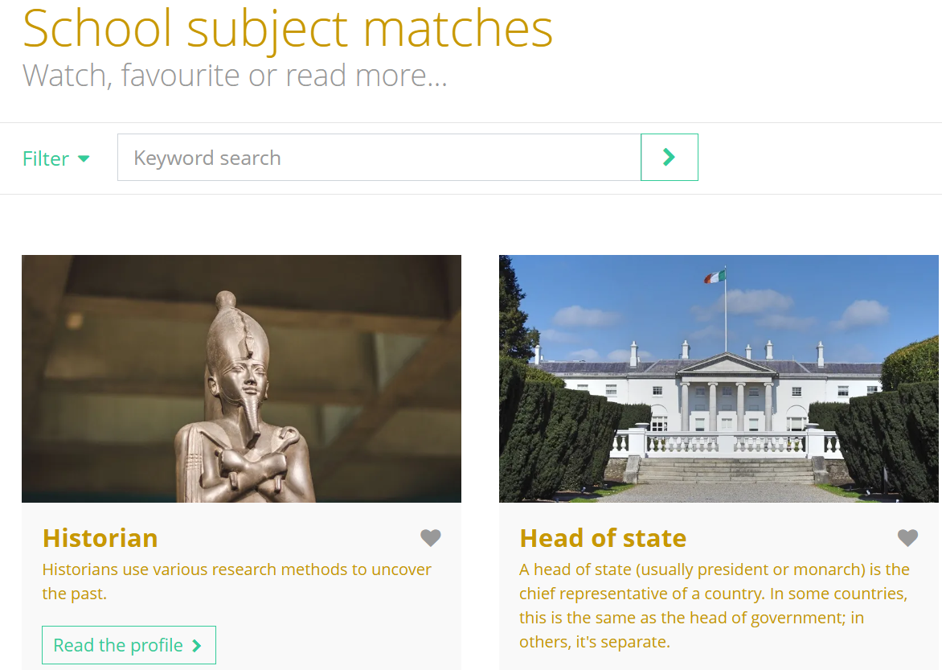
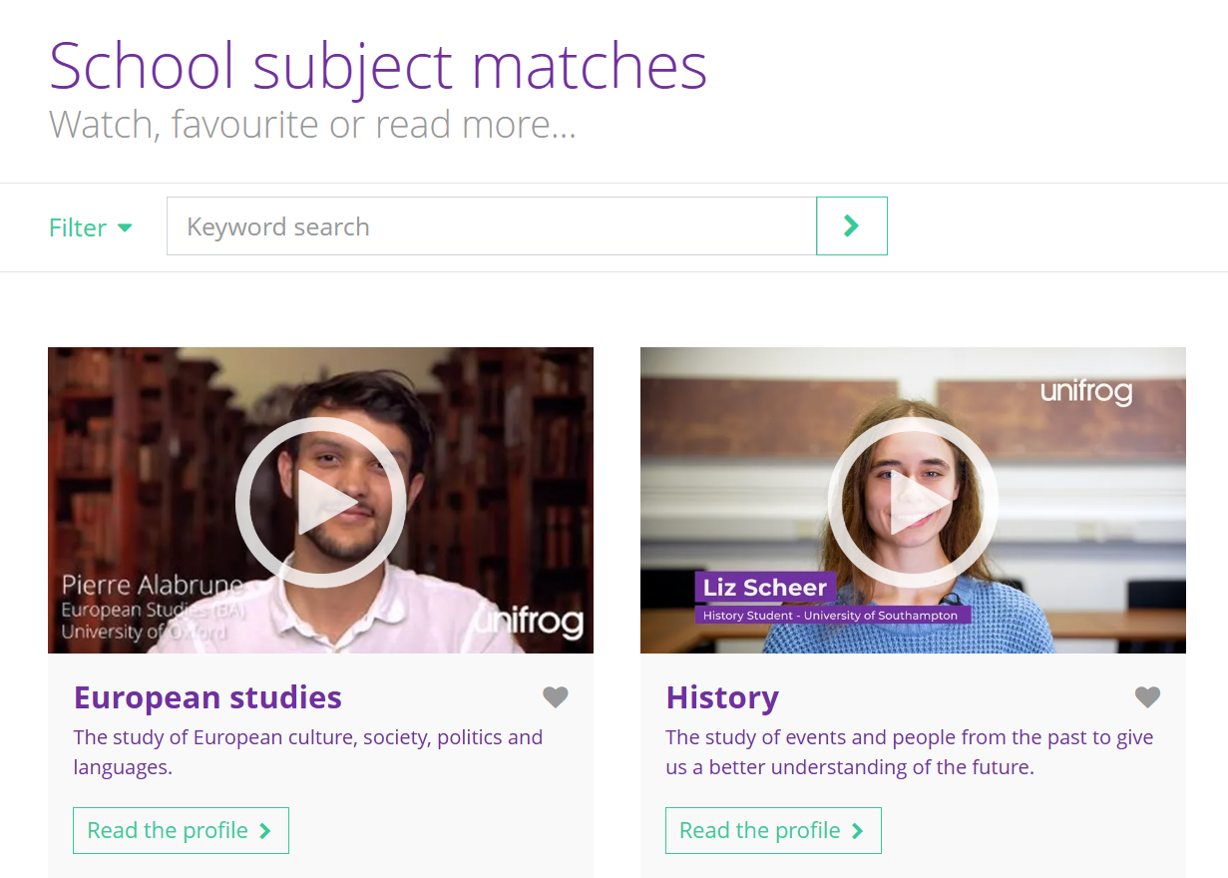
Unifrog
PSHE lessons to support the options process
What are my skills and interests?
Choosing my options
Taking control of my career journey
Working & earning
Labour market information
All students using Unifrog to help with research
All students have personal log-in details for Unifrog
Careers library is worth a visit
Notes:
Brief overview of unifrog
Explain that you can look for courses related to subject interest or indeed careers related to subject interest (share examples from History)

Slide 4
GCSE Option Blocks
Block A | Block B | Block C | Block D
Geography | Business Studies | Art | Citizenship Studies
History | Drama | Business Studies | Engineering
 | Engineering | GCSE PE | French
 | Hospitality & Catering | Health & Social Care | Hospitality & Catering
 | Triple Science | Sport Studies | Music
 |  |  | Sport Studies
 |  |  | Textiles
Key
EBacc GCSE
GCSE
Vocational

Slide 5
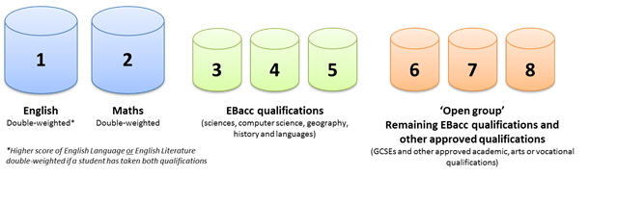
Progress 8

Slide 6
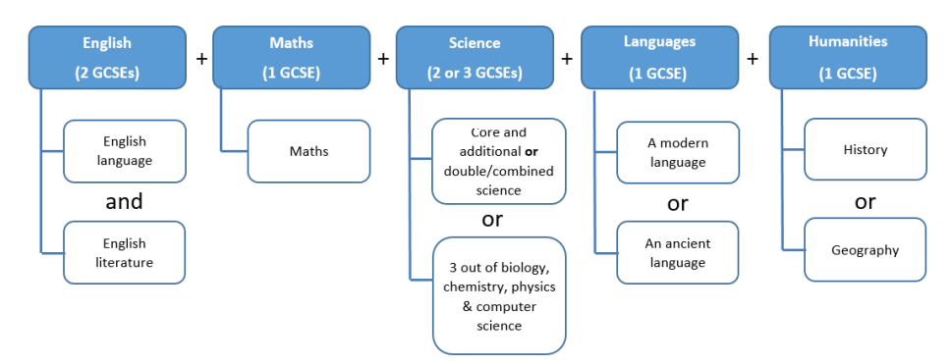
English Baccalaureate (EBacc)
The EBacc is not a qualification.
To achieve the EBacc, you need to achieve Grade 5+ in English, maths, science, a language, and either Geography or History.
The EBacc is sought after by the Russell Group universities. These are a collection of 24 UK universities that are dedicated to academic excellence.

Slide 7
Science
100% Exam at the end of Year 11
Triple Science | Trilogy (Combined Science)
3 GCSEs at the end of the course (Biology, Chemistry and Physics)
Wider range of topics
More teaching hours as more content
6 papers
Each paper is 1 hour 45 minutes
Leads into KS5 Sciences
2 GCSEs at the end of the course (Science)
Narrower range of topics
Less teaching hours as less content
6 papers
Each paper is 1 hour 15 minutes
Leads into KS5 Sciences

Slide 8
Pathways – Example 1 (Traditional GCSE)
Block A | Block B | Block C | Block D
Geography | Business Studies | Art | Citizenship Studies
History | Drama | Business Studies | Engineering
 | Engineering | GCSE PE | French
 | Hospitality & Catering | Health & Social Care | Hospitality & Catering
 | Triple Science | Sport Studies | Music
 |  |  | Sport Studies
 |  |  | Textiles

Slide 9
Pathways – Example 2 (Vocational)
Block A | Block B | Block C | Block D
Geography | Business Studies | Art | Citizenship Studies
History | Drama | Business Studies | Engineering
 | Engineering | GCSE PE | French
 | Hospitality & Catering | Health & Social Care | Hospitality & Catering
 | Triple Science | Sport Studies | Music
 |  |  | Sport Studies
 |  |  | Textiles

Slide 10
Pathways – Example 3 (Creative Arts)
Block A | Block B | Block C | Block D
Geography | Business Studies | Art | Citizenship Studies
History | Drama | Business Studies | Engineering
 | Engineering | GCSE PE | French
 | Hospitality & Catering | Health & Social Care | Hospitality & Catering
 | Triple Science | Sport Studies | Music
 |  |  | Sport Studies
 |  |  | Textiles

Slide 11
Pathways – Example 4 (Defined Career)
Block A | Block B | Block C | Block D
Geography | Business Studies | Art | Citizenship Studies
History | Drama | Business Studies | Engineering
 | Engineering | GCSE PE | French
 | Hospitality & Catering | Health & Social Care | Hospitality & Catering
 | Triple Science | Sport Studies | Music
 |  |  | Sport Studies
 |  |  | Textiles

Slide 12
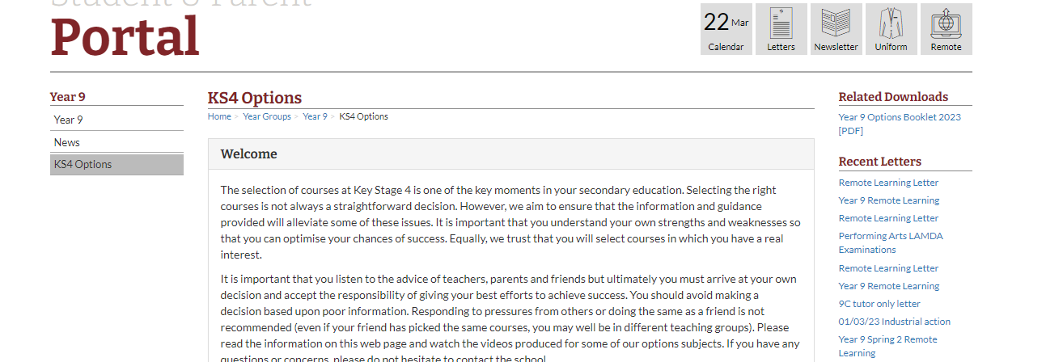
KS4 Options Portal (School Website)

Slide 13
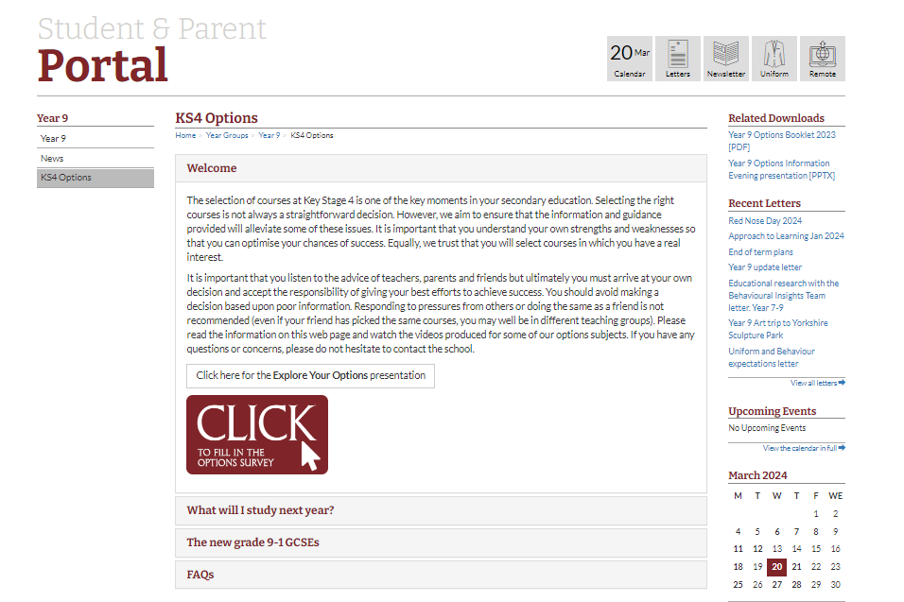

Slide 14
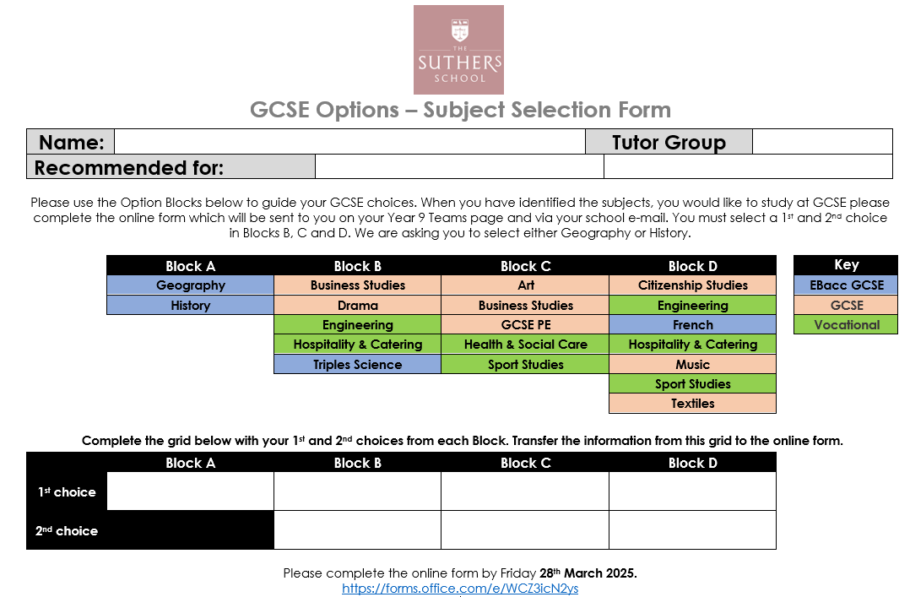
Subject Selection Form

Slide 15
Subject Selection Deadline
Complete the online form by: Friday 28th March 2025

